Slide 1



First steps in planning
the Global Multi-Hub Network
Jiří Kvaček and Frank Bisby
4D4Life Meeting, 16-18 February, Faro, Portugal

Slide 2
Aims
Architecture of Multi-Hub Network
Analysis of partners needs
Conclusions

Slide 3
Task
Task 4.1 Network consultation and workshop discussions among regional hub organisers:
Discussion of the Needs, Concepts and Specification for the Multi-Hub Network at both the taxonomic and the technical level, leading to a Preliminary Specification with outstanding issues highlighted.

Slide 4
Partners
Species 2000 China Node
Catalogo da Vida Brasil
New Zealand Organism Register (NZOR)
Integrated Taxonomic Information System (ITIS) USA
Atlas of Living Australia (ALA)
European HUB

Slide 5
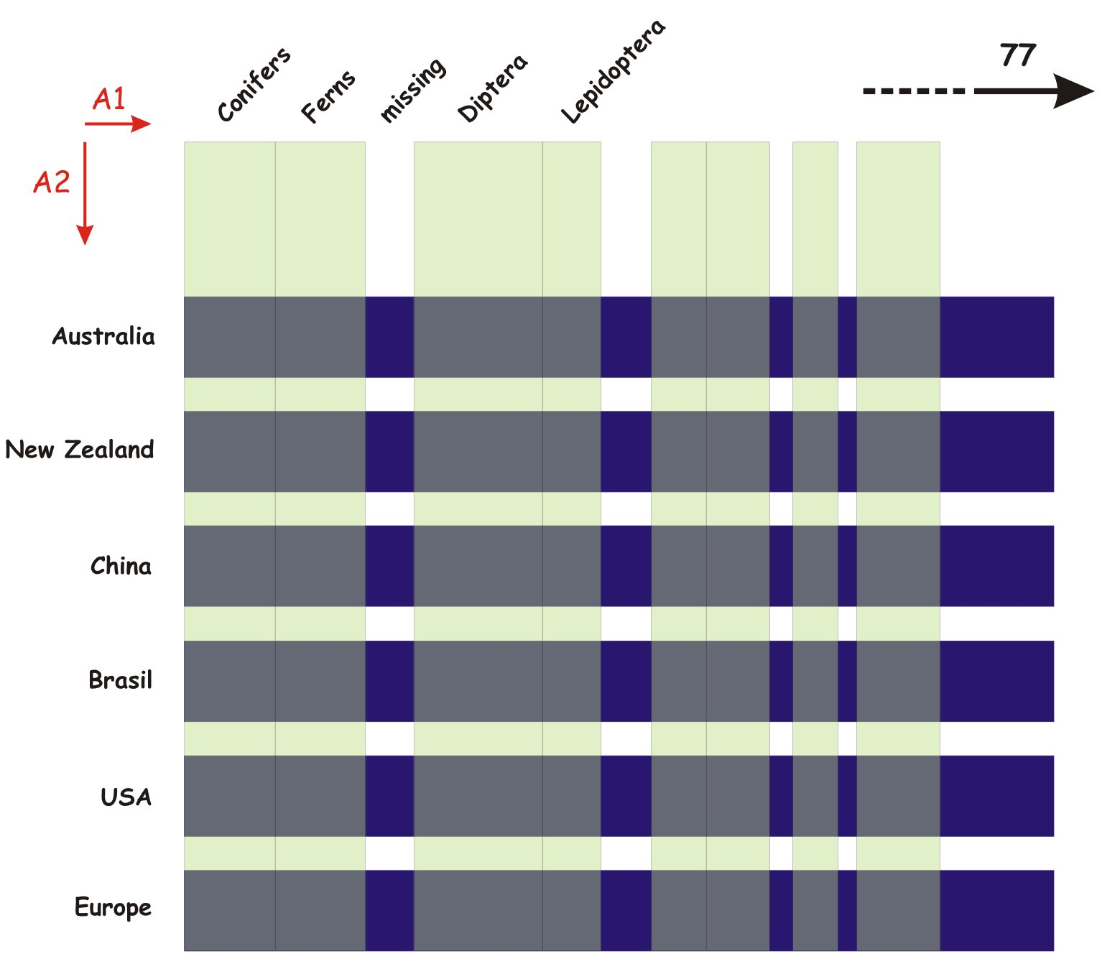
Relationship between GSDs (A1) and Regional Multi-Hub Network (A 2)

Slide 6
Expectations from Muti-Hub Network
Filling the gaps between GSDs
Production of proto GSDs

Slide 7
Tasks for technology group
Data harvesting
Data comparison, merging, cross-mapping
Developing an export tool for formation of proto GSDs and other data sets

Slide 8
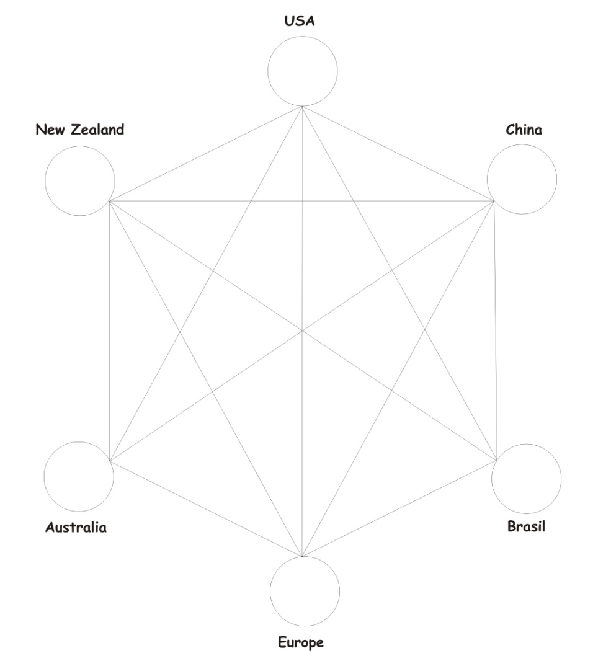
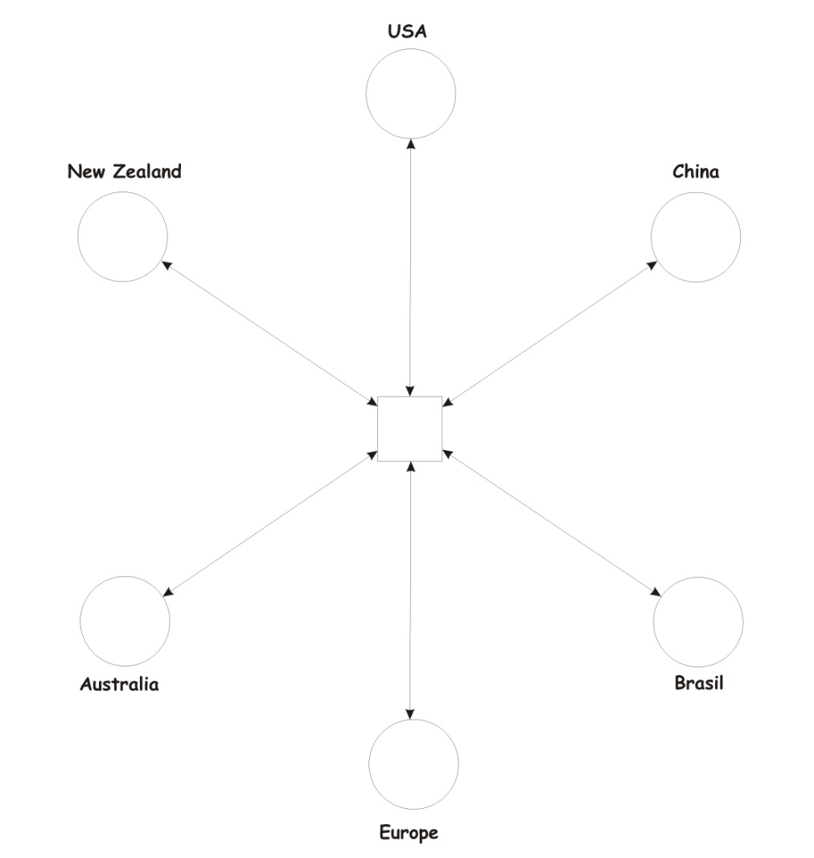
Preliminary architecture model
Three levels
FUNCTIONS
Multi-connected star
PRODUCTS
SERVICES

Slide 9
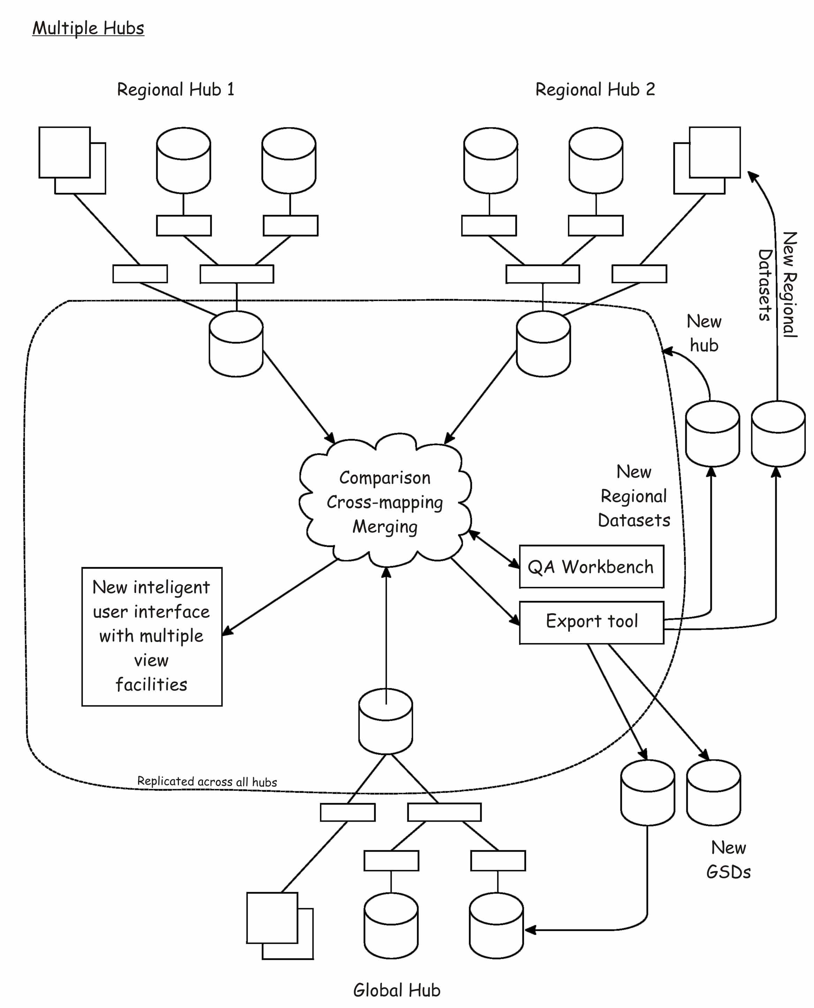
Preliminary concept

Slide 10
Analysis of partner needs
Very important functionalities: data cleaning, agregating common names, providing statistical data
Requirements for currency of updates is very variable from one week to one year updates
Multilingual interface – very useful
INTEGRATED REGIONAL databases - priority for most of the partners
Foundation of regional centers, new GSDs, mirroring usually connected with additional funding
Data sharing usually no problem except in New Zealand

Slide 11
Concluding remarks
Multi-Hub Network will:
consist of three layered star architecture with robust technology allowing:
data comparison, merging and cross-mapping
implementation of export tools for formation of proto GSDs and other data sets
provide additional functionalities e.g. for data cleaning, production of statistical data and multilingual interface

